Slide 1
Power Usage

Slide 2
Extending Tests to Desktop
1
CI Connection
2
Adding External Data to Tests
3
Saving data from Steps

Slide 3
CI Connection

Slide 4
Continuous Integration & Perfecto
Test suites are meant to be run all the time
Running your tests from a CI engine is an easy and worthwhile integration
Perfecto supports Jenkins, TeamCity and other leading platforms.
We will show a sample configuration from Jenkins which is the recommended CI
Check which CI engine will be used.

Slide 5
Prerequisites
Add the project to source control
Add to Jenkins
Maven Integration Plugin
GitLab plugin (or other source control plugin)
Configure testNG file to accept external security token <parameter name="driver.capabilities.securityToken" value="${securityToken}"></parameter>

Slide 6
Configuring Jenkins to run Perfecto tests
Create a new Maven Job
Add the security token to the job using the concealed password option.

Slide 7
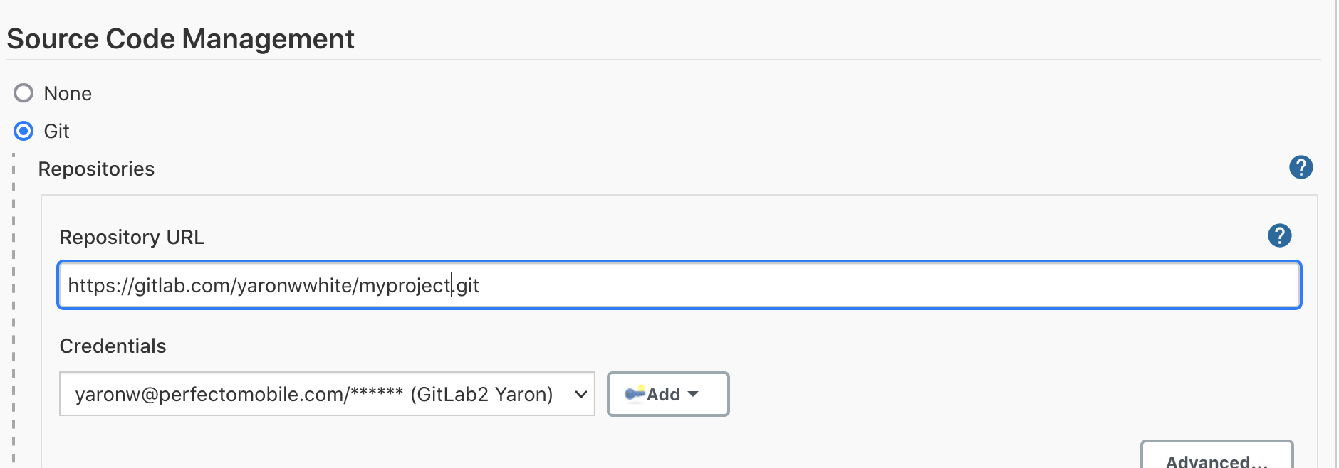
Configuring Jenkins to run Perfecto tests
Add the project to source control e.g. Github, Gitlab etc
Add link to project under the source control management section of the Job

Slide 8
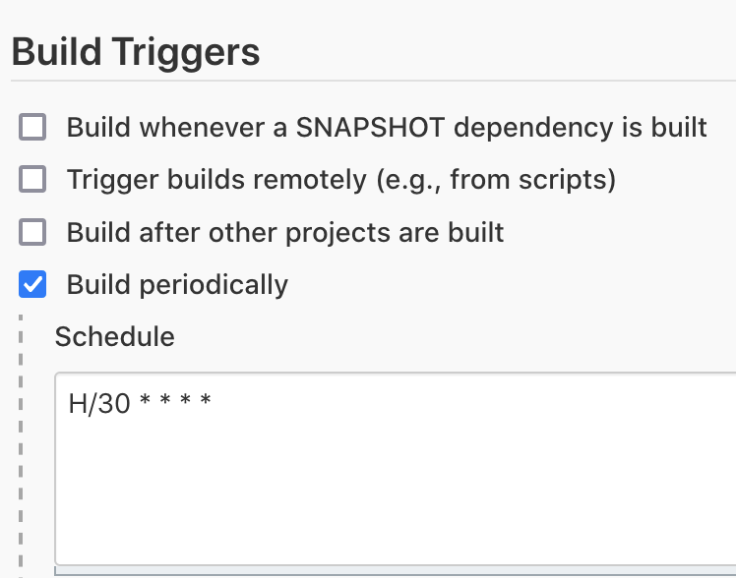
Configuring Jenkins to run Perfecto tests
Optionally Add Build Schedule to run in a scheduled manner

Slide 9
Configuring Jenkins to run Perfecto tests
Edit the Build environment to delete workspace and hide passwords

Slide 10
Configuring Jenkins to run Perfecto tests
Add build command
The root POM is – pom.xml.
The goals is:
clean install test -Dreportium-job-name="${JOB_NAME}" -Dreportium-job-number=${BUILD_NUMBER} -DtestngXmlFile=”myTestNG.xml" -DsecurityToken=${securityToken}

Slide 11
Sanity Check
Execute the build and validate that the test has been run.
The setup is now complete.

Slide 12
Adding External Data

Slide 13
Data from outside the test
Utilising external data can be a valuable enhancement to your tests
Login with multiple usernames
Check list of products
The data can be stored in a CSV, XLS or JSON file
The reference to the external data is done from the Cucumber level
View the websearch sample
Add to the scenario
Scenario outline defines the scenario as one using external data
The Example keyword is the reference to the actual file

Slide 14
Saving Data from steps

Slide 15
Saving data at runtime
As we run through our test we may want to capture data for use in a future step.
Product price or name
Account balance
To do this we save the data using a Quantum util
ConfigurationManager.getBundle().setProperty(”propertyName", value);
We can retrieve the data from any step during the execution
String val = ConfigurationManager.getBundle().getString(”propertyName");

Slide 16
Questions?

Slide 17
THANK YOU

